Slide 1
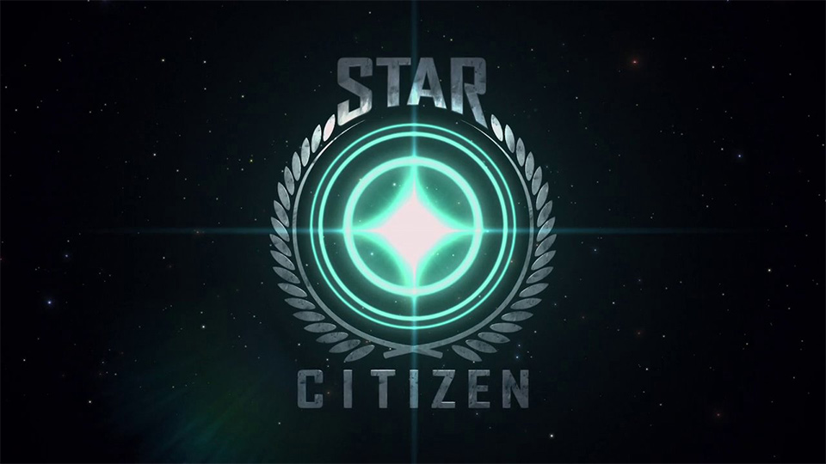

Slide 2

What is Star Citizen
Star Citizen is a crowd funded game development project made by Cloud Imperium Games.
It’s currently the biggest crowd funded project with 44 million dollars pledged.
The project is currently under development and the final product will be PC game supporting both single and multiplayer
At the moment the product is sold via “pledges”. People pledge various amounts to support the development of the game and receive in return pledge rewards: access to various stages of the development version “alpha / beta access”, the finished game, as well as in game (virtual) assets.
All the pledge rewards are received at the time of their completion since the whole product is under development
Star Citizen Website

Slide 3
How is Star Citizen made
The nature of the crowd funded projects dictates that the interested parties pledge support for the product prior to it’s development.
Due to the nature of the crowd funding the development is flexible and new features and goals are added or existing features are expanded as additional funds are secured
Funding goals are set when the current goal is reached a new threshold is announced with general description of the features that will be unlocked upon reaching it
The development process is with heavy emphasis on the community. There are several video shows (some of them with live streaming) that are being produced on weekly or monthly basis. There is a lot of interaction between the developers and the community making the whole development process interactive and highly visible.

Slide 4
Who are the customers
The initial target group was fans of several old space simulator games () made by the lead designer and the CEO of the company making Star Citizen
The audience has expanded quickly due to viral sharing
Since there are very few titles in this genre of games at the moment and the demand is high enough the current audience is currently reaching around 500000 people with the game in it’s second year of development and at least 1 year remaining until the final product will be available

Slide 5
Where is it sold
The product is sold exclusive over the internet internationally and the sales are treated as donations / pledges.
There are some physical merchandize that is sold – like T-shirts, ship models etc.. It’s also sold over the internet
All transactions are made via the game’s website with several payment options supported – PayPal, Amazon, card transfers etc.

Slide 6
How is it sold
The initial pledge campaign was predeceased by a teaser site with general information about project by the lead designer of several old games being in development without any defiles
On 10 October 2012 an official reveal was made with a trailer movie.
At that point a crowd funding with several money thresholds and their goals (in term of development) were set on the game’s web site.
Due to overwhelming interest a Kick starter campaign was also launched
After the Kick starter campaign was finished the total funds secured were over 6 million dollars.
At this point the crowd funding was continued on the web site with addition of new stretch goals
Different pledge rewards or merchandize were added after in order to keep the interest and receive more funding

Slide 7
Profitability
From the available information it can be concluded that the project is highly profitable.
For the period of 18 months in development the project has raised 44 million dollars and this is prior to having a finished product.
Even with no concrete information about the actual costs we can estimate the profit based on the following data.
Current number of employs: around 200; The hearing of employs has been gradual over the period of time so we can make assumption of average 120 employees over 18 months period. With the average yearly salary for Game Developers being around 100000$ and keeping in mind that not all the employees are developers this amounts to 18 million dollars expenses. If we increase this by 50% to cover for additional expenses it’s 27 mil. $ expenses or 17 mil. $ profit.
* This calculation is heavily based on untested assumptions due to the lack of concrete and detailed data about the project expenses.

Slide 8
Sustainability
Keeping in mind that most of the estimated profit from the previous slide will be also invested in development, we can assume that the project will have to attract more people to pledge since there is at least 1 year of development remaining.
Due to saturation of the target audience the income from new pledges will gradually drop.
The current income can be sustained via releasing of virtual assets and physical merchandize since they are viable options for people that have already pledged to get the game itself.
Upon releasing the finished version there will be income increase consistent with a standard game release, since there are indications that a lot of potential customers are waiting for the finished product.
After official launch there are several income options available such as – selling in game items, transaction fees for player sold add-ons, physical goods, etc..

